Slide 1
Maths
Unit 6 – Fractions and Percentages.
WALT:
6Nf.03 Use knowledge of equivalence to write fractions in their simplest form.

Slide 2



WALT: Use knowledge of equivalence to write fractions in their simplest form.
I can write equivalent fractions of a given fraction.
I can find the simplest form of a fraction.
I can use equivalence to order fractions with different denominators.

Slide 3
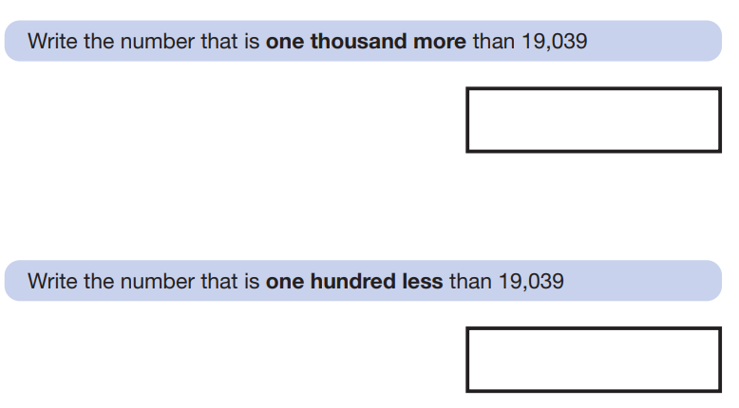
Retrieval Practice
WALT: Use knowledge of equivalence to write fractions in their simplest form.
20,039
18,939

Slide 4
Homework
WALT: Use knowledge of equivalence to write fractions in their simplest form.
ESL - Workbook sections 2.3 + 2.4,
Maths - Workbook pages 77 - 85.
Science - Worksheet

Slide 5
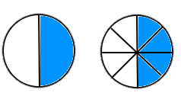

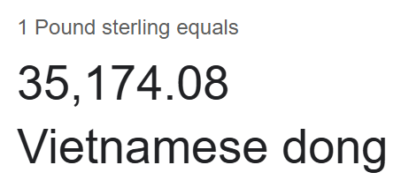
Starter – What is equivalence?
WALT: Use knowledge of equivalence to write fractions in their simplest form.

Slide 6
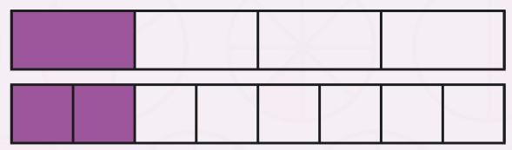
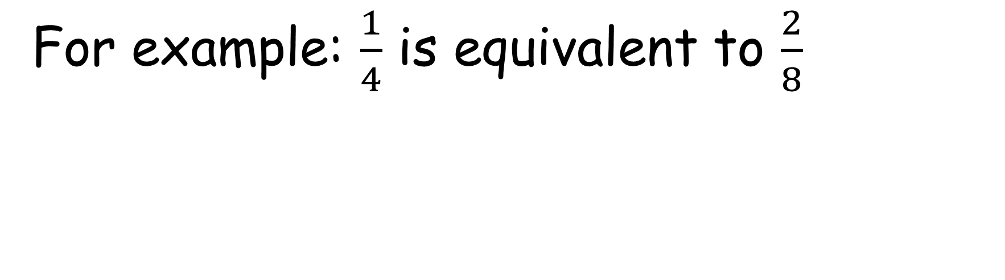
Equivalent fractions are fractions that are an equal amount but written with a different numerator and denominator.
WALT: Use knowledge of equivalence to write fractions in their simplest form.
For example: $\frac{1}{4}$ is equivalent to $\frac{2}{8}$

Slide 7
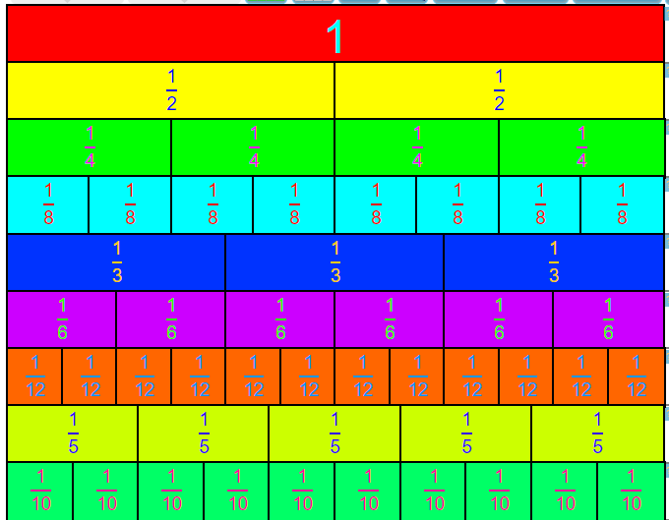
We can use fraction walls to help us find equivalent fractions.
WALT: Use knowledge of equivalence to write fractions in their simplest form.
https://www.visnos.com/demos/fraction-wall
On your whiteboards write some fractions you think are equivalent.
We will use the fraction wall to check them.

Slide 8
WALT: Use knowledge of equivalence to write fractions in their simplest form.
6Nf.03 Use knowledge of equivalence to write fractions in their simplest form.
What is meant by the simplest form?
The simplest form of a fraction is when the numerator and denominator do not have any common factors (other than 1).

Slide 9
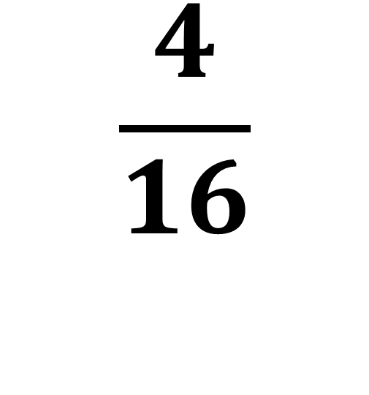
Let’s look at how to simplify a fraction together.
WALT: Use knowledge of equivalence to write fractions in their simplest form.
We know that 4 and 16 are both even.
This means they both have a factor of 2.
This means we can divide both the numerator and the denominator by 2.
$$\frac{4}{16}$$

Slide 10
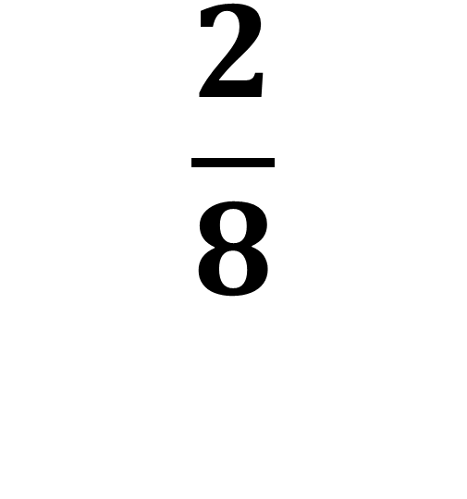
Let’s look at how to simplify a fraction together.
WALT: Use knowledge of equivalence to write fractions in their simplest form.
We know that 2 and 8 are both even.
This means they both have a factor of 2.
This means we can divide both the numerator and the denominator by 2.
$$\frac{2}{8}$$

Slide 11

Let’s look at how to simplify a fraction together.
WALT: Use knowledge of equivalence to write fractions in their simplest form.
$$\frac{1}{4}$$
1 and 4 have no common factors (other than 1) so this fraction is in its simplest form.

Slide 12
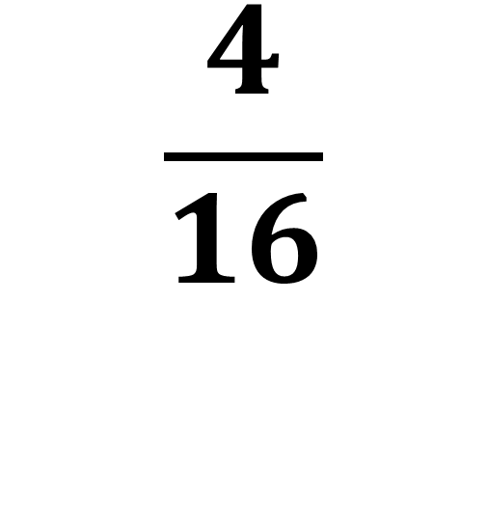
Let’s look at how to simplify a fraction together.
WALT: Use knowledge of equivalence to write fractions in their simplest form.
$$\frac{4}{16}$$
While the previous method of simplifying the fraction in stages works it is quicker to divide by the largest factor we know straight away.
What is the largest factor of 4 and 16?

Slide 13
Let’s look at how to simplify a fraction together.
WALT: Use knowledge of equivalence to write fractions in their simplest form.
If we divide both 4 and 16 by four we get 1 and 4.
1 and 4 have no common factors (other than 1) so this fraction is in its simplest form.
$$\frac{1}{4}$$

Slide 14
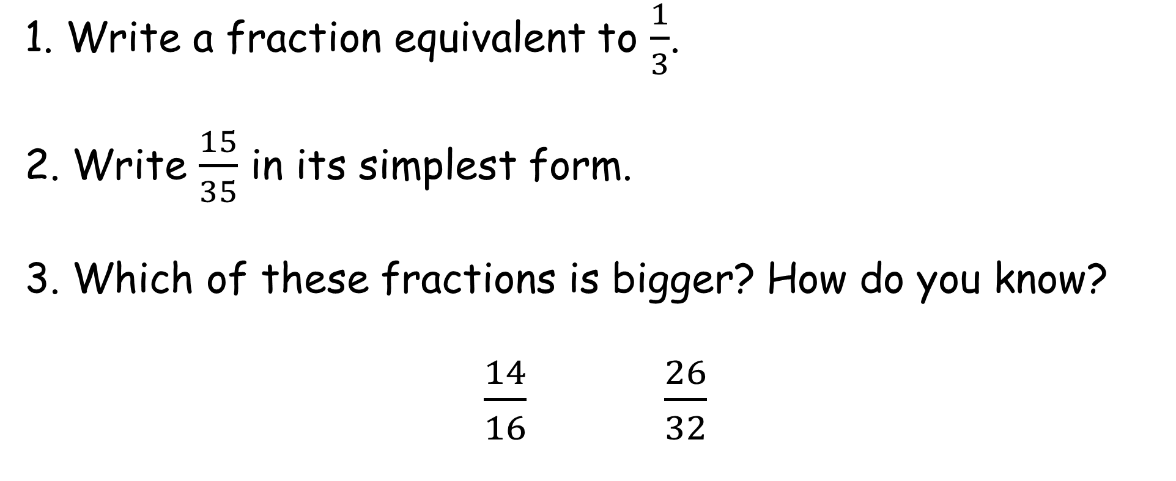
Check your understanding
WALT: Use knowledge of equivalence to write fractions in their simplest form.
1. Write a fraction equivalent to $\frac{1}{3}$.
2. Write $\frac{15}{35}$ in its simplest form.
3. Which of these fractions is bigger? How do you know?
$\frac{14}{16}$ $\frac{26}{32}$

Slide 15





Check your understanding
WALT: Use knowledge of equivalence to write fractions in their simplest form.
$$\frac{4}{12}$$
1. Write a fraction equivalent to $\frac{1}{3}$.
2. Write $\frac{15}{35}$ in its simplest form.
3. Which of these fractions is bigger? How do you know?
$\frac{14}{16}$ $\frac{26}{32}$
$$\frac{2}{6}$$
$$\frac{3}{9}$$
$$etc.$$
$$\frac{3}{7}$$

Slide 16
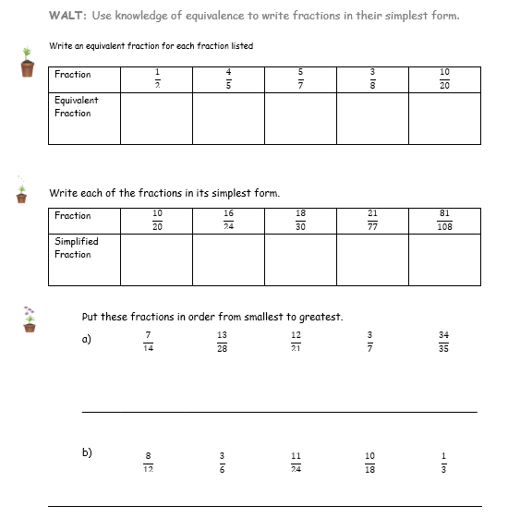
WALT: Use knowledge of equivalence to write fractions in their simplest form.
Finished everything?
Write your own questions about finding the simplest form of fractions.

Slide 17
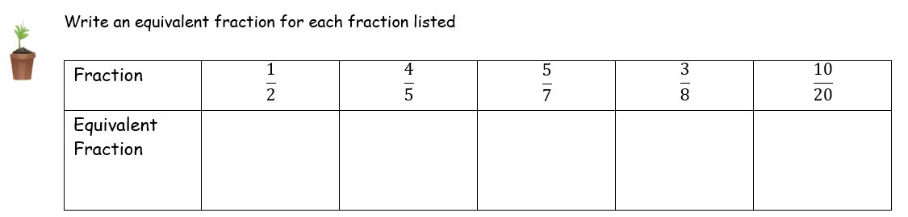





WALT: Use knowledge of equivalence to write fractions in their simplest form.
$$\frac{2}{4}$$
$$\frac{8}{10}$$
$$\frac{10}{14}$$
$$\frac{6}{16}$$
$$\frac{5}{10}$$

Slide 18
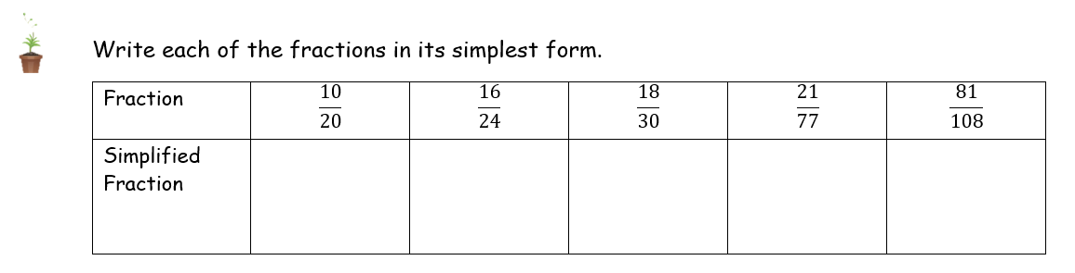





WALT: Use knowledge of equivalence to write fractions in their simplest form.
$$\frac{1}{2}$$
$$\frac{2}{3}$$
$$\frac{3}{5}$$
$$\frac{3}{11}$$
$$\frac{3}{4}$$

Slide 19
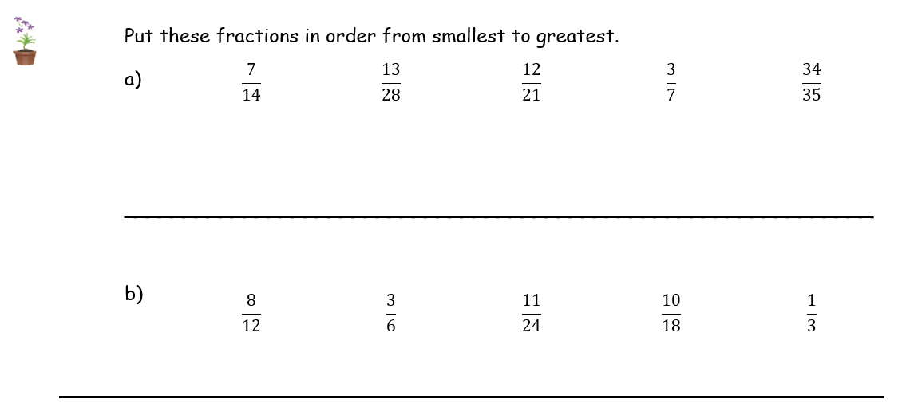










WALT: Use knowledge of equivalence to write fractions in their simplest form.
$$\frac{3}{7}$$
$$\frac{13}{28}$$
$$\frac{7}{14}$$
$$\frac{12}{21}$$
$$\frac{34}{35}$$
$$\frac{1}{3}$$
$$\frac{11}{24}$$
$$\frac{3}{6}$$
$$\frac{10}{18}$$
$$\frac{8}{12}$$

Slide 20
WALT: Use knowledge of equivalence to write fractions in their simplest form.
I can write equivalent fractions of a given fraction.
I can find the simplest form of a fraction.
I can use equivalence to order fractions with different denominators.

Slide 21
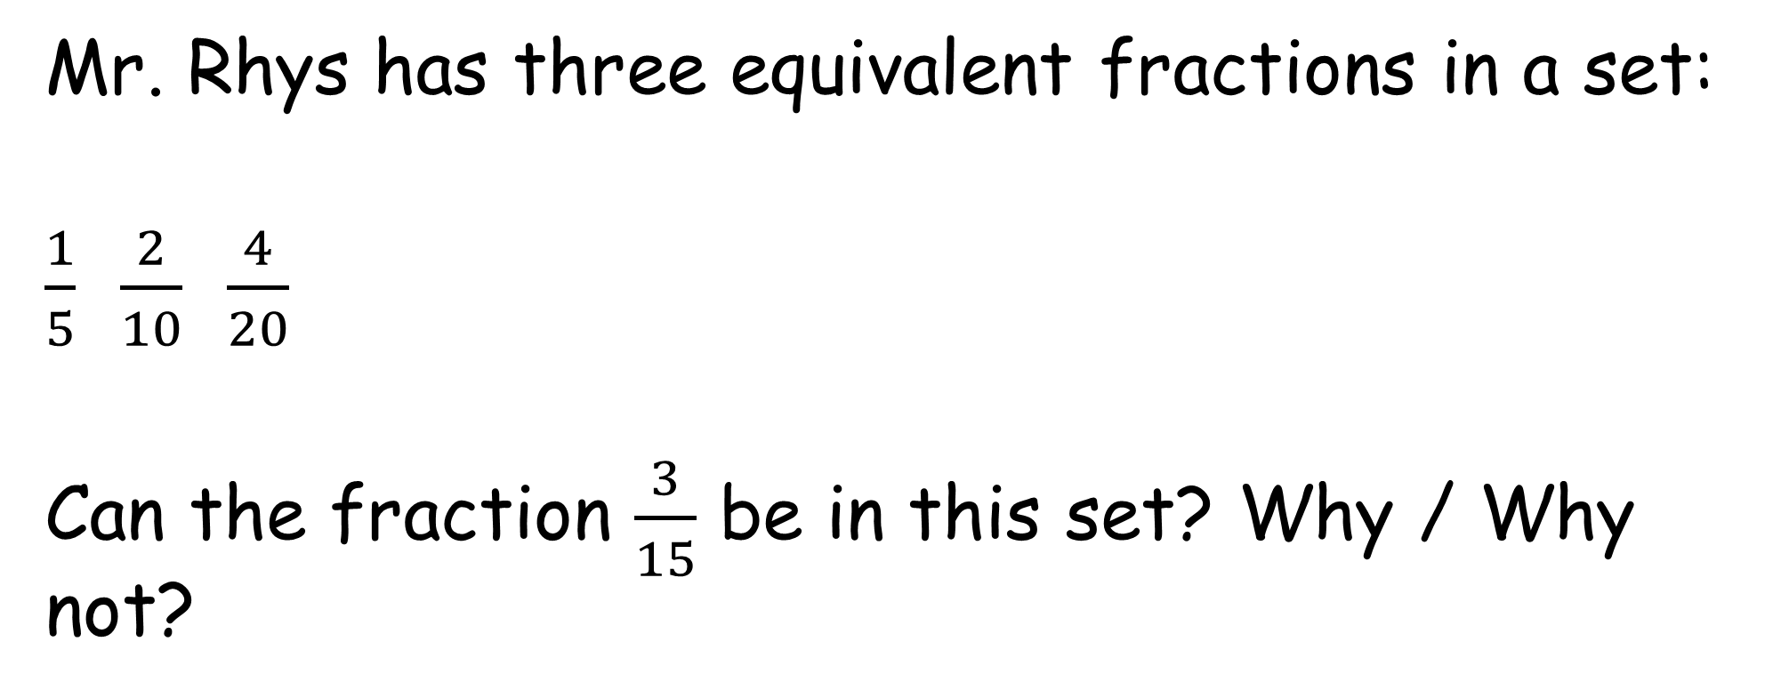
Plenary –
WALT: Use knowledge of equivalence to write fractions in their simplest form.
Mr. Rhys has three equivalent fractions in a set:
$\frac{1}{5}$ $\frac{2}{10}$ $\frac{4}{20}$
Can the fraction $\frac{3}{15}$ be in this set? Why / Why not?

